Slide 1

Modeling V

Slide 2
Introduction
Fiercely Read Chapter 18 (R4DS)
Previously: Numeric Variables
New Focus
Categorical Predictor Variables
Interaction Effects
Different Categorical Variables
Principled
Arbitrary
Understand Using Multiple Datasets and Visualizations

Slide 3
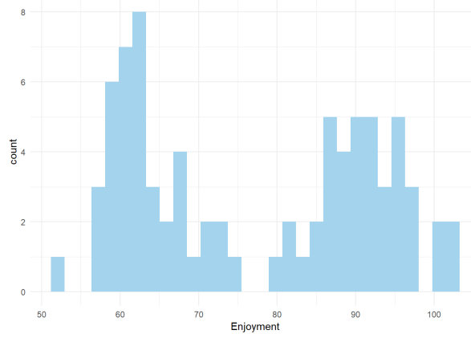
Example 1
Data Overview
Enjoyment (E)
Food (F)
Condiment (C)
80 Observations
Enjoyment Visualized

Slide 4
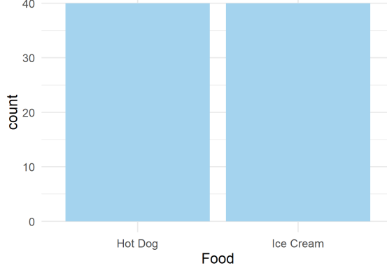
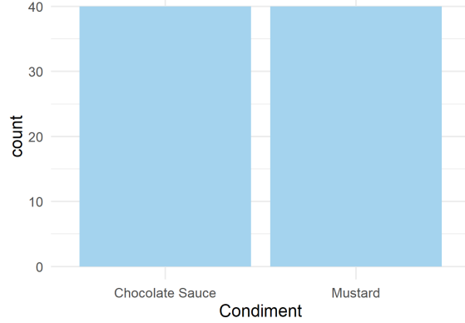
Example 1
Food Visualized
Condiment Visualized

Slide 5
Example 1
Question of Interest
Can We Predict a Person’s Culinary Enjoyment if…
We Serve Them a Particular Item:
Hot Dog
Ice Cream
With a Particular Condiment
Mustard
Chocolate Sauce
?

Slide 6
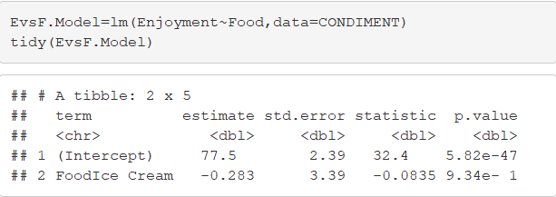

Example 1
Regressing E on F
$\hat{E}=77.5−0.283F$
Questions:
What Does 77.5 Represent?
What About -0.283?

Slide 7
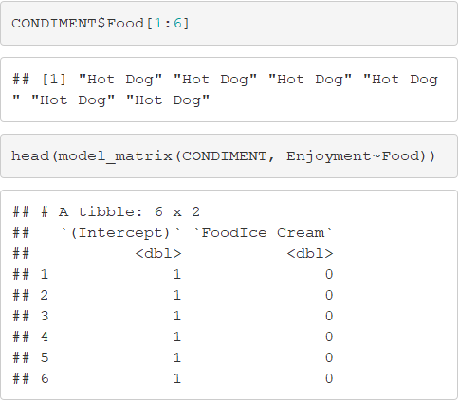
Example 1
What is R Doing?

Slide 8
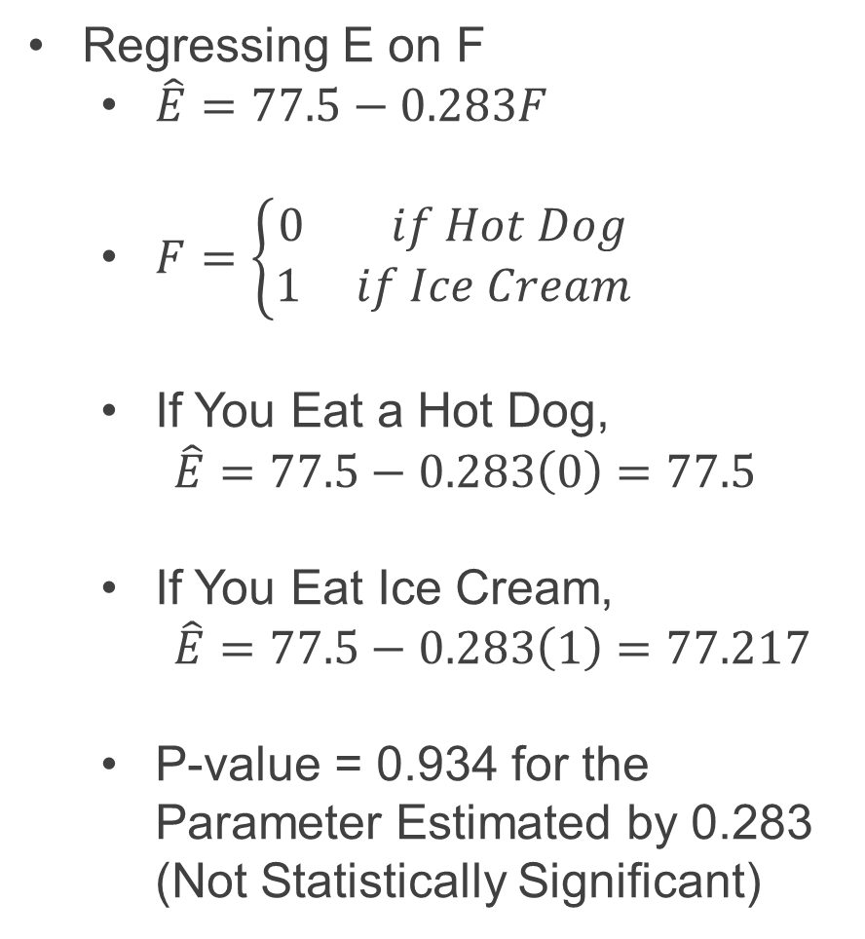
Example 1
Regressing E on F
$\hat{E}=77.5−0.283F$
$F=\left\{\begin{aligned}0 if Hot Dog \\ 1 if Ice Cream\end{aligned}\right.$
If You Eat a Hot Dog,
$\hat{E}=77.5−0.283\left(0\right)=77.5$
If You Eat Ice Cream,
$\hat{E}=77.5−0.283\left(1\right)=77.217$
P-value = 0.934 for the Parameter Estimated by 0.283 (Not Statistically Significant)

Slide 9
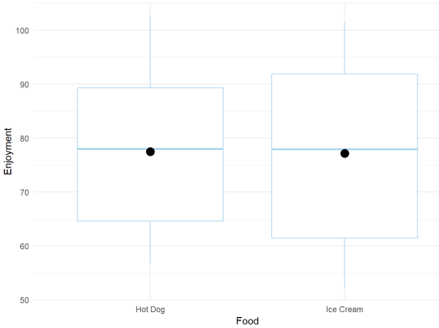
Example 1
Understanding This Visually
Predicted Values Under Model

Slide 10
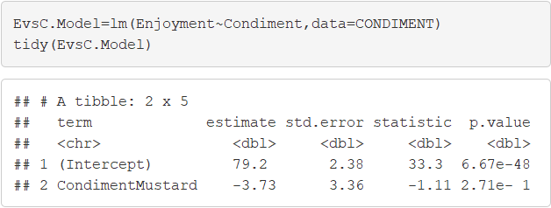
Example 1
Regressing E on C
Significant: P-value < 0.05
Not Significant: P-value > 0.05

Slide 11
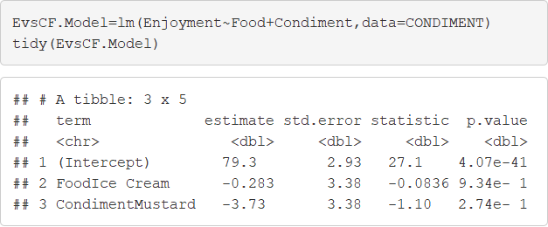

Example 1
Regressing E on C + F
$\hat{E}=79.3−0.283F−3.73C$
$F=\left\{\begin{aligned}0 if Hot Dog \\ 1 if Ice Cream\end{aligned}\right.$
$C=\left\{\begin{aligned}0 if Chocolate Sauce \\ 1 if Mustard\end{aligned}\right.$
What does 79.3 Represent?

Slide 12
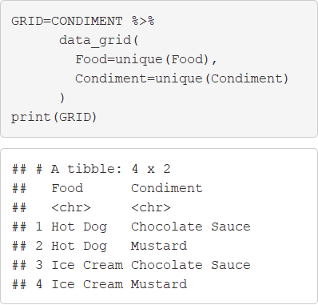
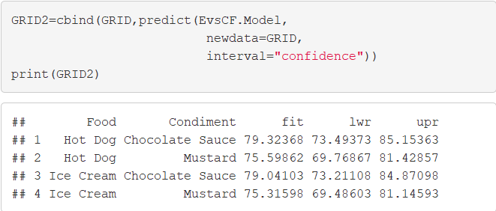
Example 1
Obtaining Predicted Values

Slide 13
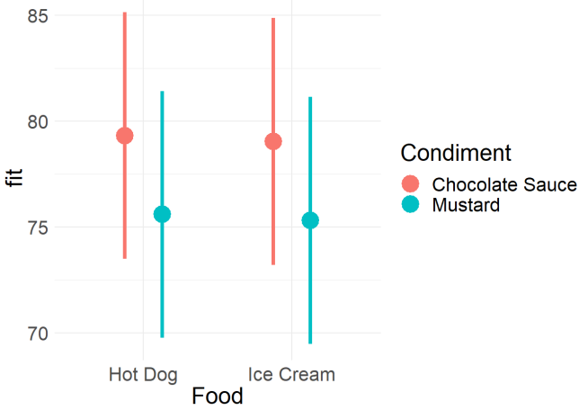
Example 1
Understanding This Visually
Notice the Overlap

Slide 14
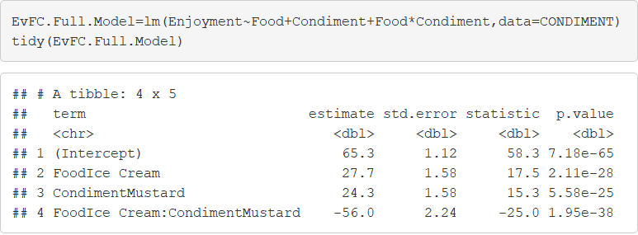
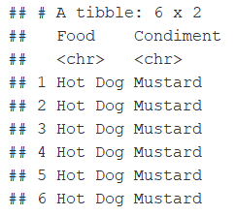
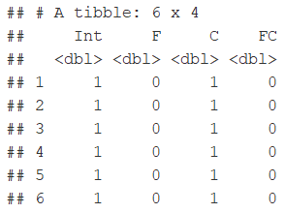
Example 1
Interaction Effect

Slide 15
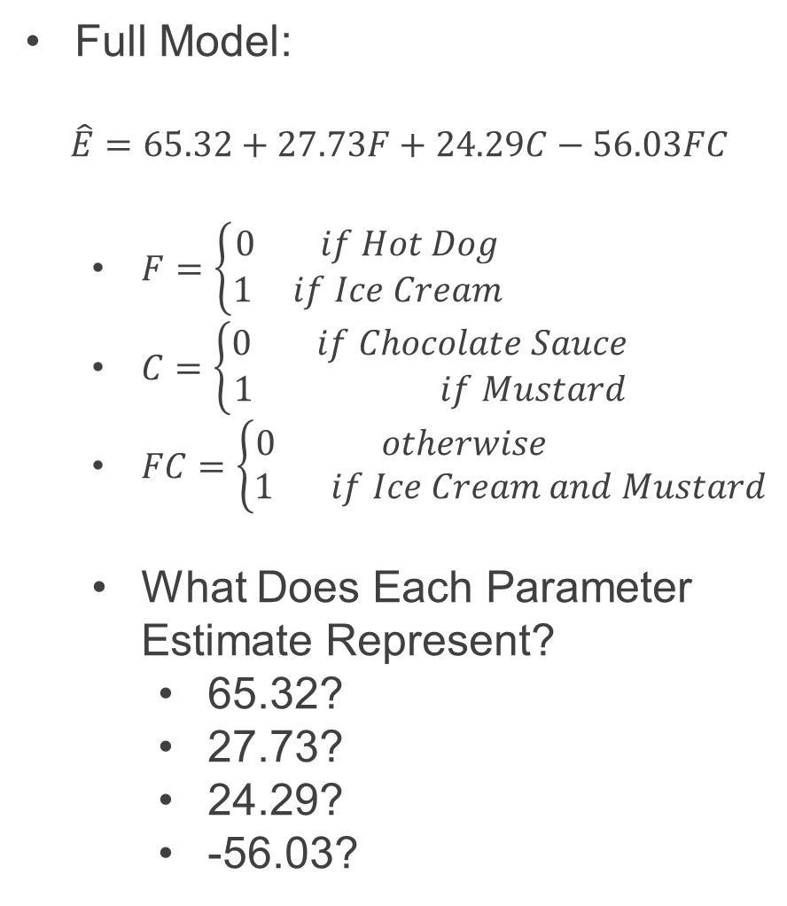
Example 1
Full Model:
$$\hat{E}=65.32+27.73F+24.29C−56.03FC$$
$F=\left\{\begin{aligned}0 if Hot Dog \\ 1 if Ice Cream\end{aligned}\right.$
$C=\left\{\begin{aligned}0 if Chocolate Sauce \\ 1 if Mustard\end{aligned}\right.$
$FC=\left\{\begin{aligned}0 otherwise \\ 1 if Ice Cream &&and Mustard\end{aligned}\right.$
What Does Each Parameter Estimate Represent?
65.32?
27.73?
24.29?
-56.03?

Slide 16
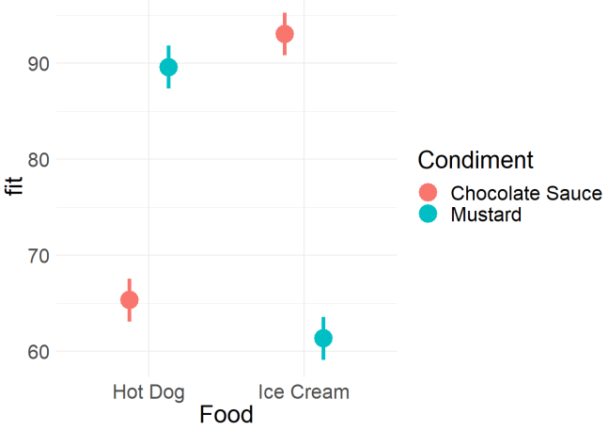
Example 1
Understanding This Visually
What Is Different?

Slide 17
Example 1
Summary
Analysis of Variance (ANOVA)
Numerical Response Variable
Categorical Explanatory Variables
Purpose:
Generalize t-test
Estimate Difference in Means Between Groups
Experimental Designs

Slide 18
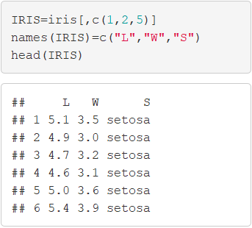
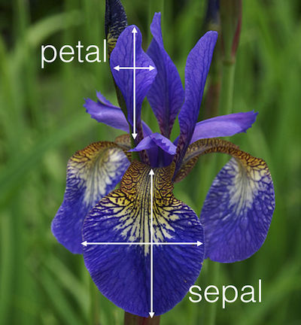
Example 2
Data Overview
Popular Built-in Data
Sepal.Width (W)
Sepal.Length (L)
Species (S)
150 Observations
> iris

Slide 19
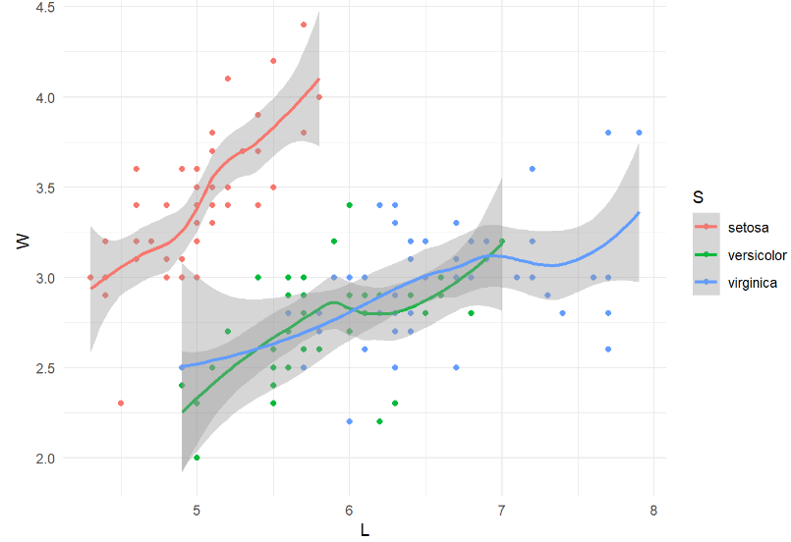
Example 2
Question of Interest
Visual of Relationship
Can We Explain the Variation in Sepal Width Using Sepal Length and Species (setosa,versicolor,virginica)?

Slide 20
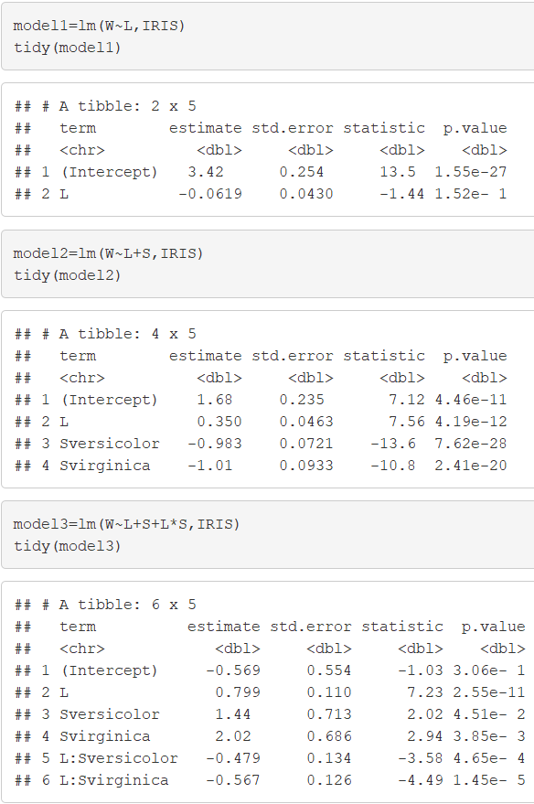
Example 2
Multiple Models

Slide 21
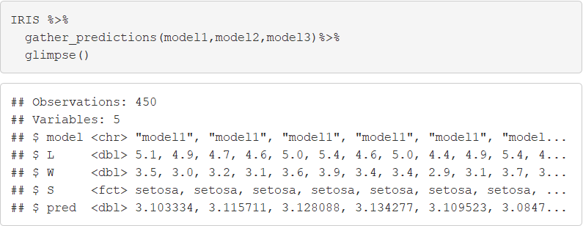
Example 2
Gathering Predictions
Variable Named “model”
Allows Us To Quickly Create Graphics That Compare Models
150 Predictions for 3 Models

Slide 22
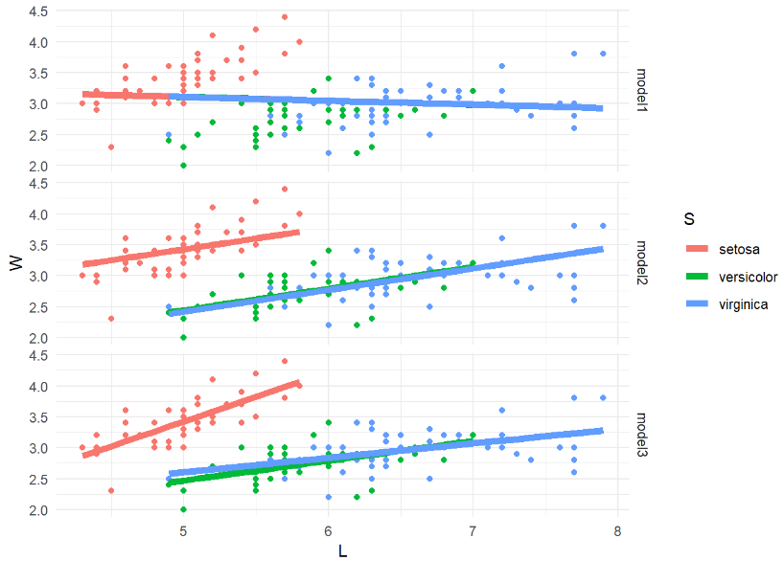
Example 2
Visualizing Models

Slide 23
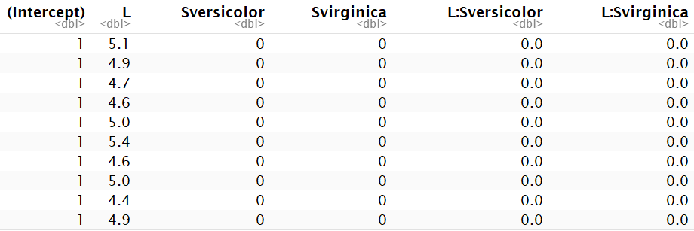
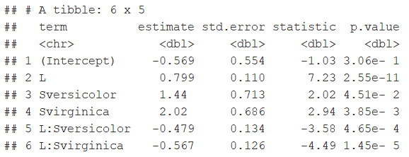
Example 2
Full Model Matrix
Full Model Estimated
Adjustment
In Mean
Adjustment
In Slope

Slide 24
Example 2
Summary
Analysis of Covariance (ANCOVA)
Numerical Response Variable
Categorical & Numerical Explanatory Variables

Slide 25
Closing
Disperse and Make Reasonable Decisions

